Slide 1



Convolutional Neural Networks
卷积神经网络
布树辉

Slide 2

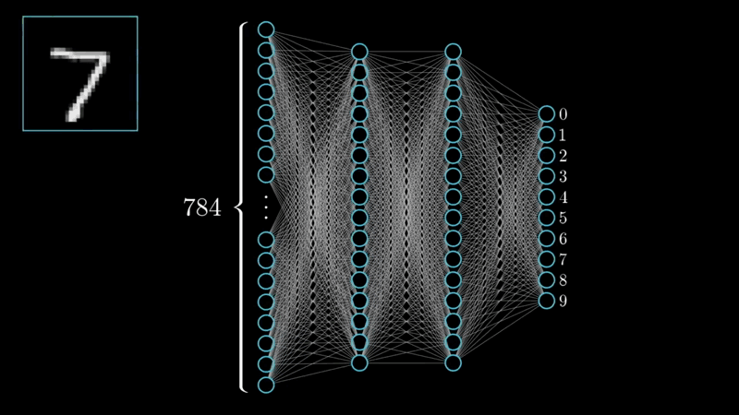

Neural Networks
Neural networks
sample
label
A
B
C

Slide 3
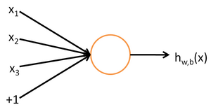
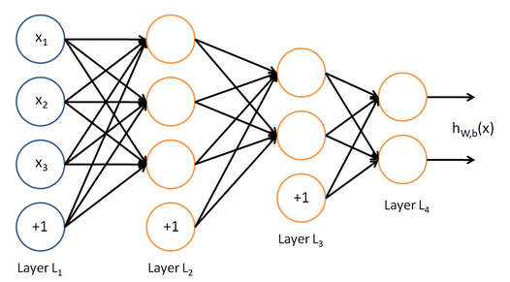
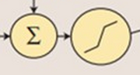
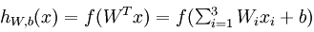
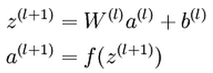
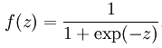
Neural Networks - Feedforward Networks

Slide 4
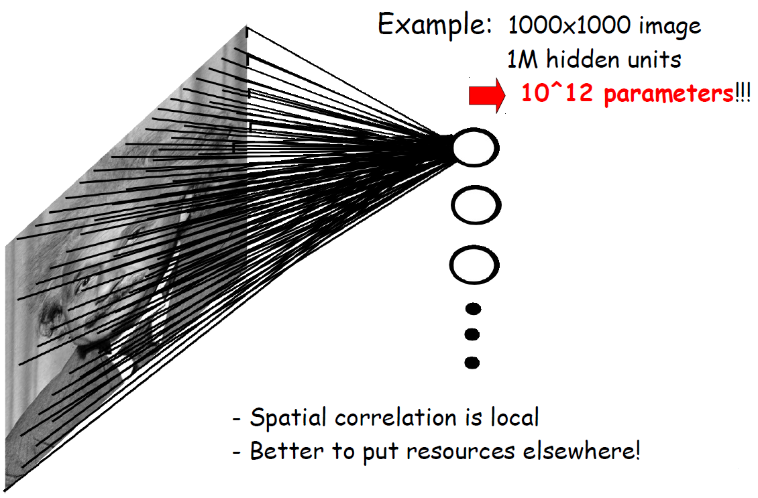
Fully Connected Neural Networks

Slide 5
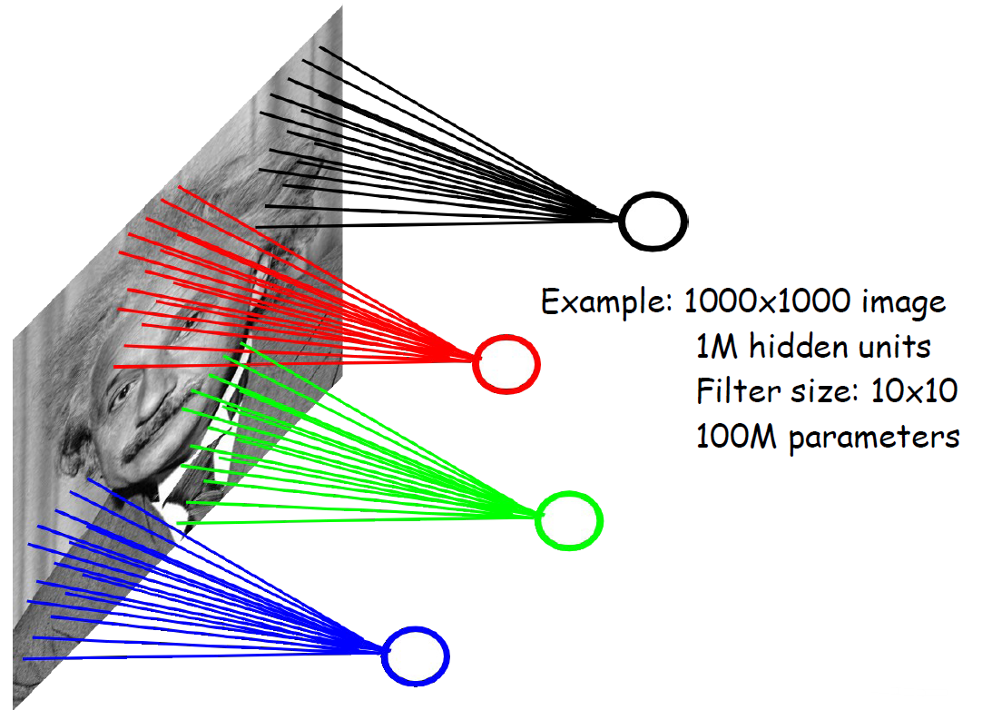
Locally Connected Neural Networks
input：10x10
output: 1
10^8 parameters

Slide 6
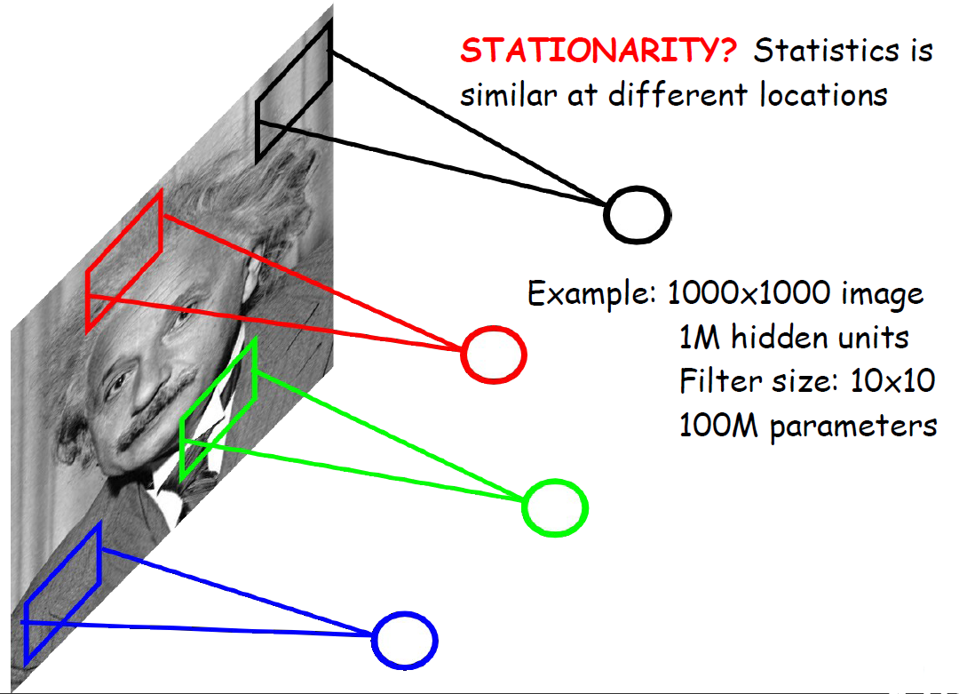
Locally Connected Neural Networks

Slide 7
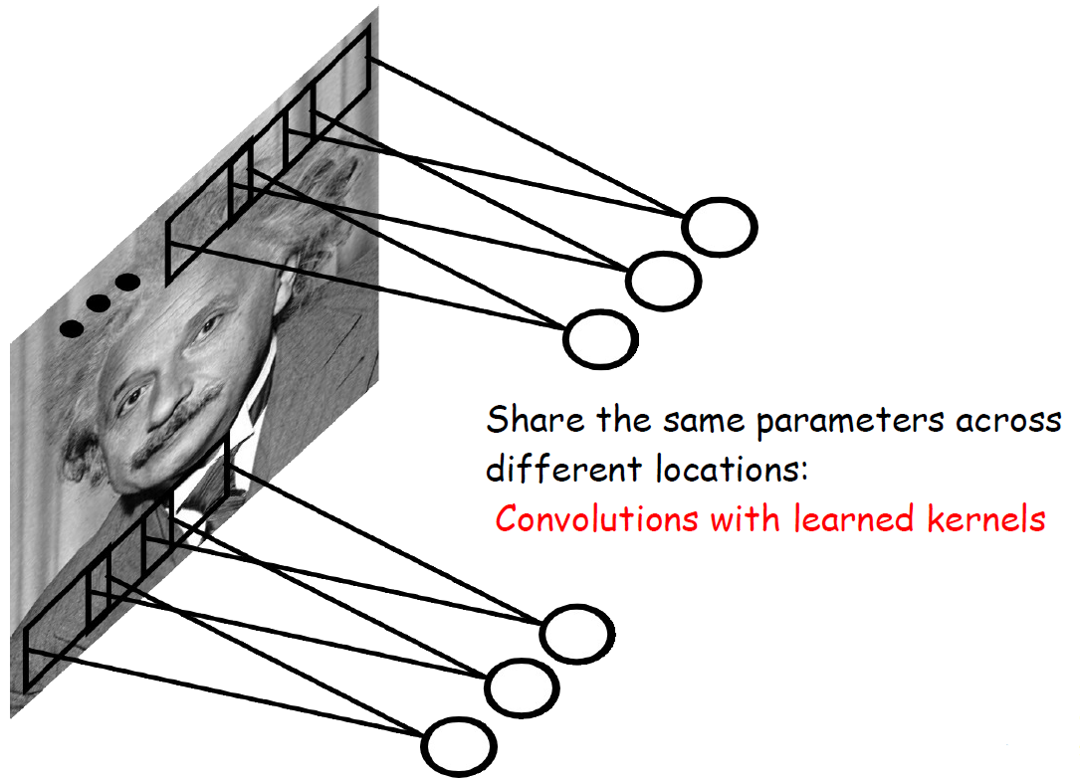
Locally Connected Neural Networks

Slide 8
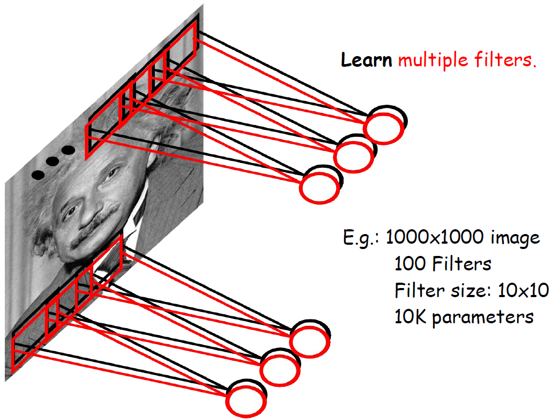
Locally Connected Neural Networks
10^4 parameters

Slide 9
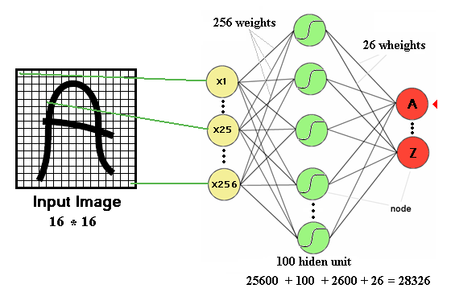
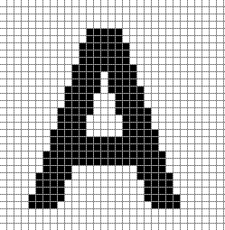
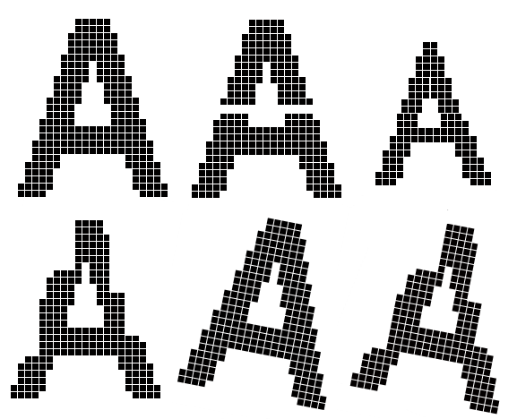
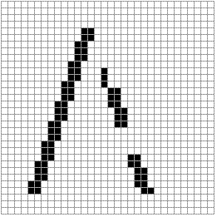
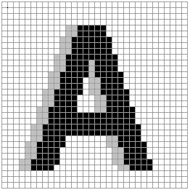
Neural Networks - Disadvantages
The number of trainable parameters becomes extremely large
Little or no invariance to shifting, scaling, and other forms of distortion

Slide 10
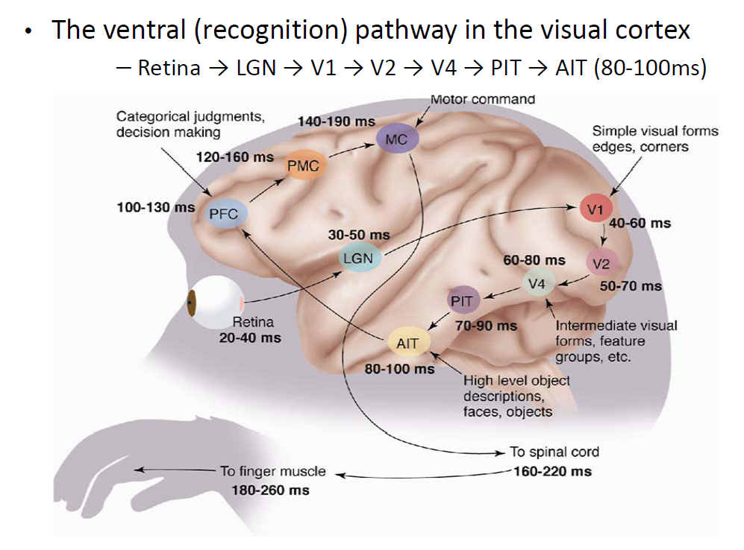
Mammalian Visual Pathway - Hierarchical

Slide 11
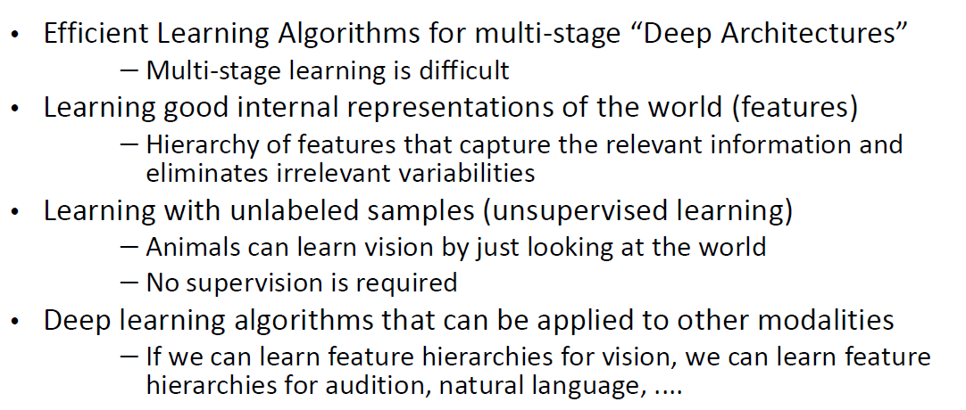
Challenges

Slide 12
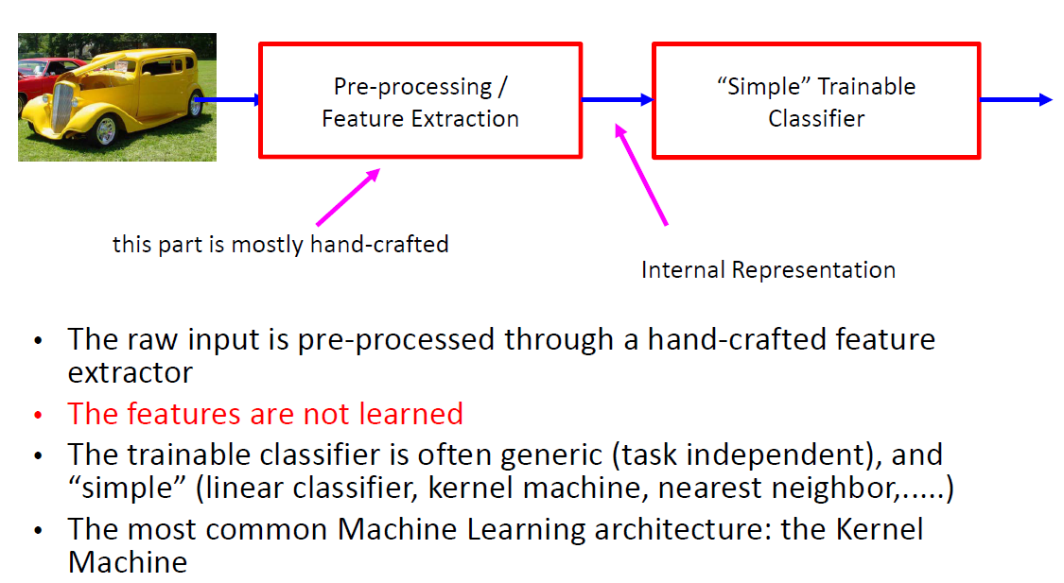
Shallow Architecture for Recognition

Slide 13
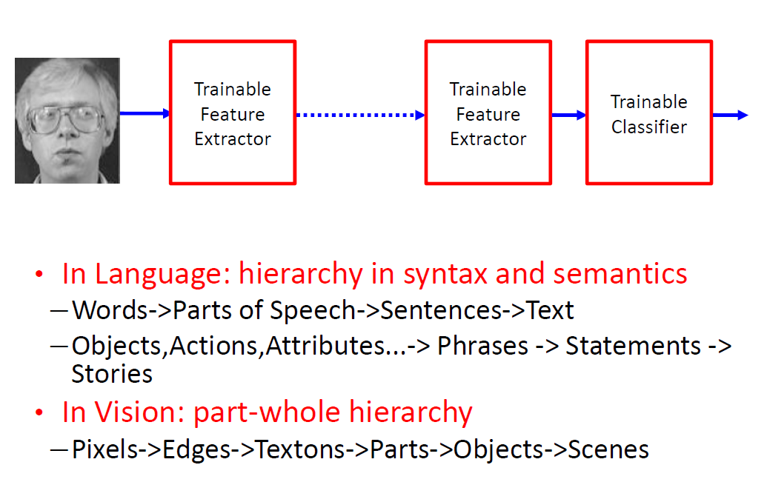
Good Representations - Hierarchical

Slide 14
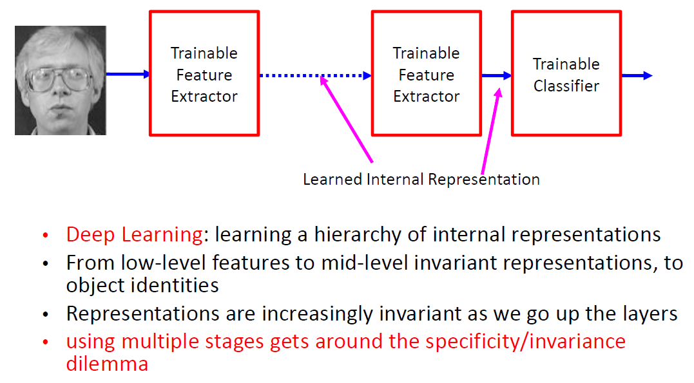
Deep Learning - Hierarchical Representations

Slide 15
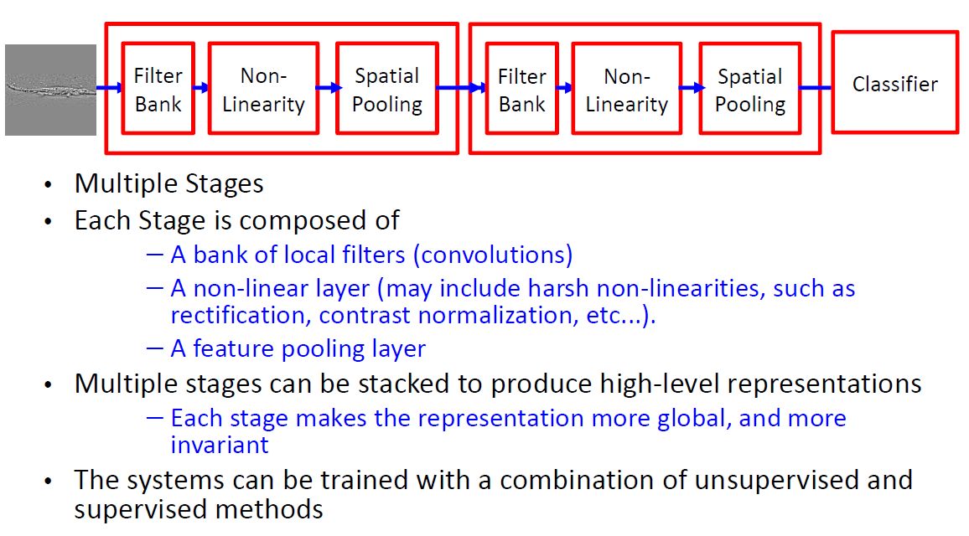
Hierarchical / Deep Architectures

Slide 16
Neural Network for Vision
A standard neural network applied to images:
Scales quadratically with the size of the input
Does not leverage stationarity
Solution:
Connect each hidden unit to a small patch of the input
Share the weight across hidden units
This is called: Convolutional Neural Network

Slide 17
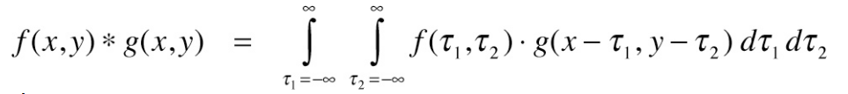
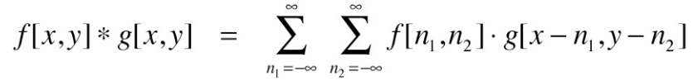
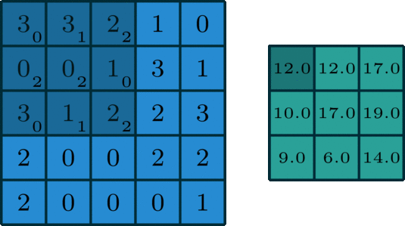
Convolution - Math Definition

Slide 18
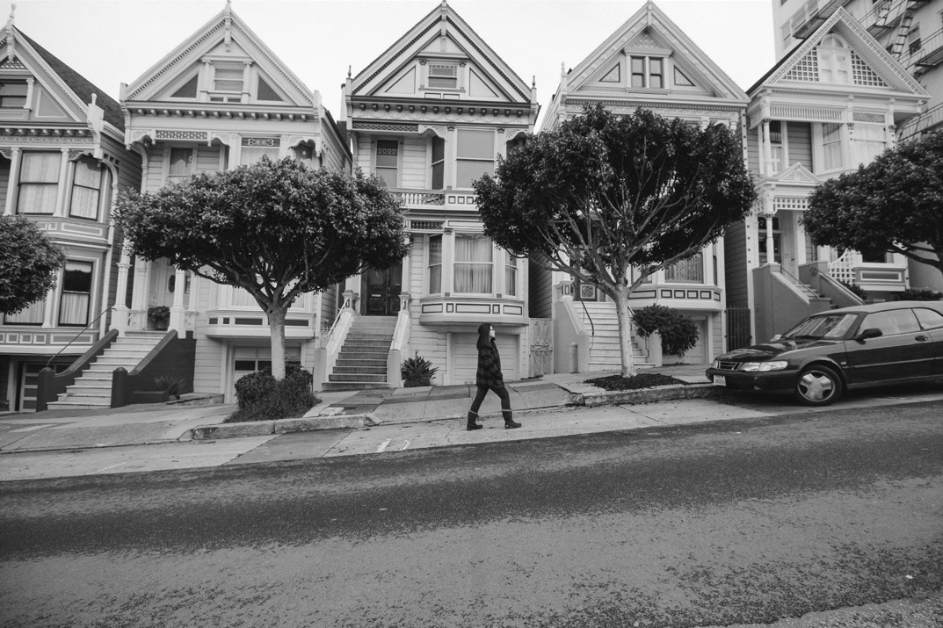
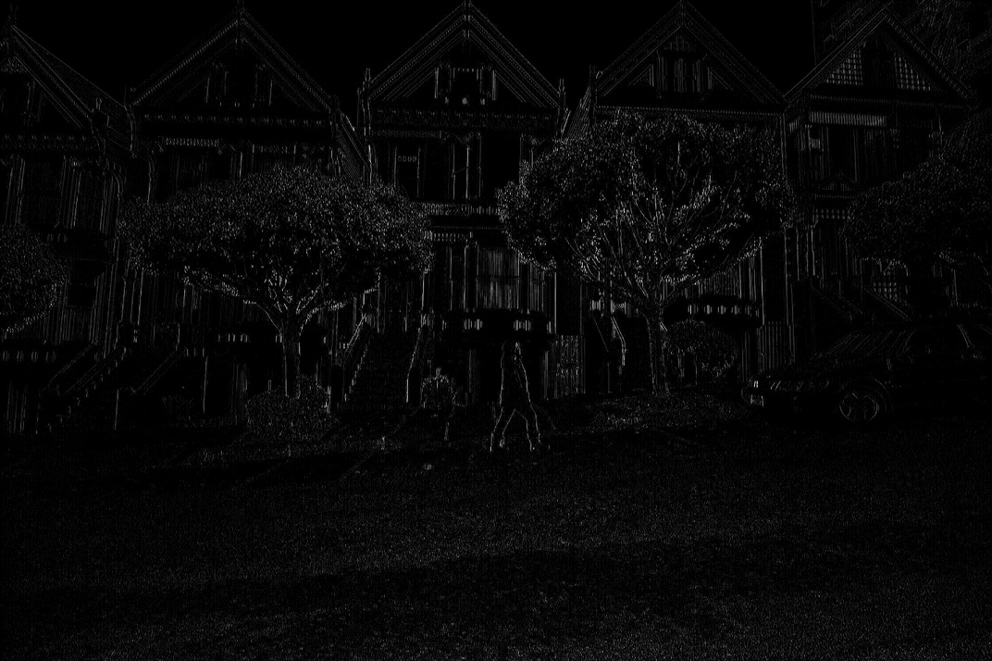
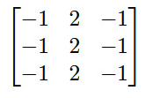
Convolution - Effect
*
=

Slide 19
Convolution - Operation
f(x,y)
g(x,y)
mf=3
1 | 2 | 3 | 4
5 | 6 | 7 | 8
9 | 8 | 7 | 6
1 | 2 | 3
-1 | 0 | 1
2 | 1 | 2
mg=3
*
nf=4
ng=3
shape=full
0 | 0 | 0 | 0 | 0 | 0 | 0 | 0
0 | 0 | 0 | 0 | 0 | 0 | 0 | 0
0 | 0 | 1 | 2 | 3 | 4 | 0 | 0
0 | 0 | 5 | 6 | 7 | 8 | 0 | 0
0 | 0 | 9 | 8 | 7 | 6 | 0 | 0
0 | 0 | 0 | 0 | 0 | 0 | 0 | 0
0 | 0 | 0 | 0 | 0 | 0 | 0 | 0
第1行和最后1行
加入mg-1行0
1 | 4 | 10 | 16 | 17 | 12
4 | 14 | 32 | 38 | 40 | 28
6 | 25 | 58 | 57 | 50 | 34
1 | 9 | 32 | 37 | 29 | 22
18 | 25 | 40 | 35 | 20 | 12
2 | 1 | 2
1 | 0 | -1
3 | 2 | 1
第1列和最后1列
加入ng-1列0
*
=
将卷积核绕其中心
旋转180度
Notes:
https://blog.csdn.net/qq_25762497/article/details/51052861
https://blog.csdn.net/appleyuchi/article/details/78597516
https://www.cnblogs.com/yanghelin/p/8025820.html
https://www.leiphone.com/news/201908/wq1m4fNK8LNuG0Rs.html

Slide 20
Convolution - Operation
shape=same
0 | 0 | 0 | 0 | 0 | 0 | 0 | 0
0 | 0 | 0 | 0 | 0 | 0 | 0 | 0
0 | 0 | 1 | 2 | 3 | 4 | 0 | 0
0 | 0 | 5 | 6 | 7 | 8 | 0 | 0
0 | 0 | 9 | 8 | 7 | 6 | 0 | 0
0 | 0 | 0 | 0 | 0 | 0 | 0 | 0
0 | 0 | 0 | 0 | 0 | 0 | 0 | 0
2 | 1 | 2
1 | 0 | -1
3 | 2 | 1
14 | 32 | 38 | 40
25 | 58 | 57 | 50
9 | 32 | 37 | 29
=
*
import numpy as np
f=np.array([[1,2,3,4],[5,6,7,8],[9,8,7,6]])
g=np.array([[1,2,3],[-1,0,1],[2,1,2]])
import scipy.signal
print(scipy.signal.convolve(f,g))
print(scipy.signal.convolve(g,f))

Slide 21
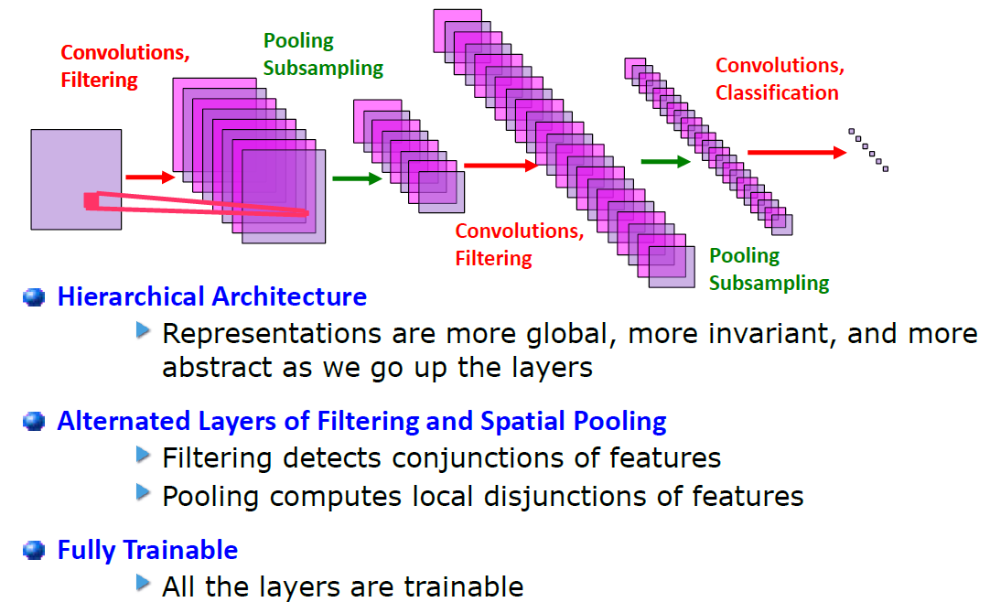
Convolutional Neural Network - Architecture

Slide 22

Convolutional Neural Network - Demo

Slide 23
Convolutional Neural Networks - Properties
CNN is a feed-forward network that can extract topological properties from an image.
Like almost every other neural networks they are trained with a version of the back-propagation algorithm.
They can recognize patterns with extreme variability (such as handwritten characters).

Slide 24

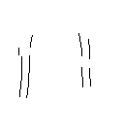

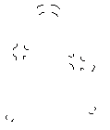
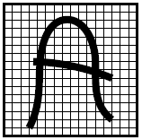


Convolutional Layer - Demonstration
-1
0
1
Convolve with
-1
0
1
features
-1
0
1
w11
w12
w13
w11
w12
w13
w21
w22
w23
w21
w22
w23
w31
w32
w33
w31
w32
w33

Slide 25

Convolutional Layer - Demonstration

Slide 26


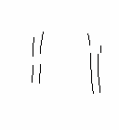
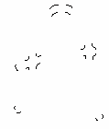

Convolutional Layer - Multi-kernel Demonstration

Slide 27


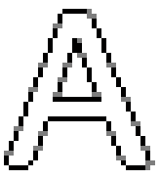


Subsampling
Feature map
By reducing the spatial resolution of the feature map, reduce the effect of noises and shift or distortion.
the weight sharing is also applied in subsampling layers

Slide 28
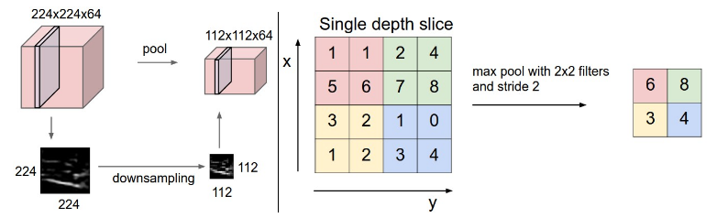
Subsampling
Pooling layer downsamples the volume spatially, independently in each depth slice of the input volume.
Left: In this example, the input volume of size [224x224x64] is pooled with filter size 2, stride 2 into output volume of size [112x112x64]. Notice that the volume depth is preserved.
Right: The most common downsampling operation is max, giving rise to max pooling, here shown with a stride of 2. That is, each max is taken over 4 numbers (little 2x2 square).

Slide 29
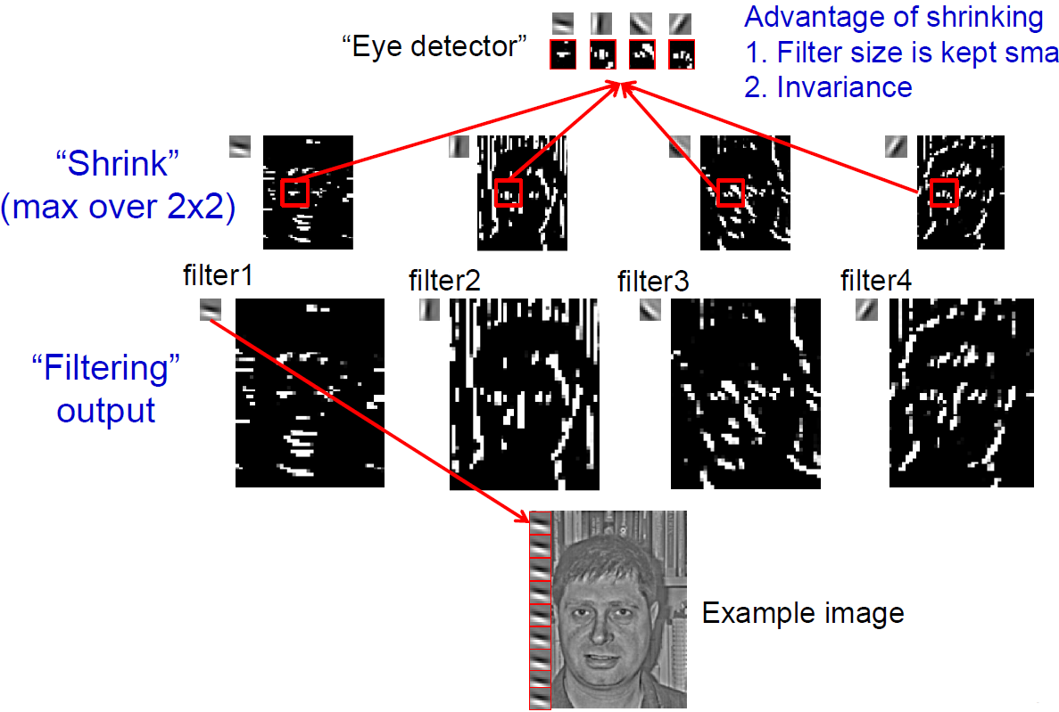
Illustration - Learning “Eye” Detector

Slide 30
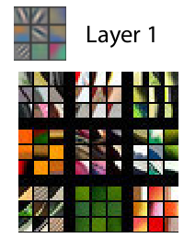
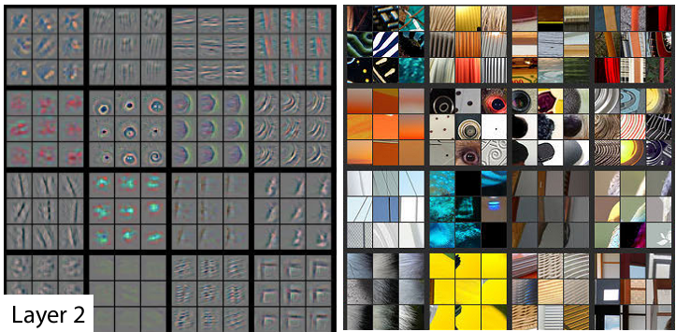
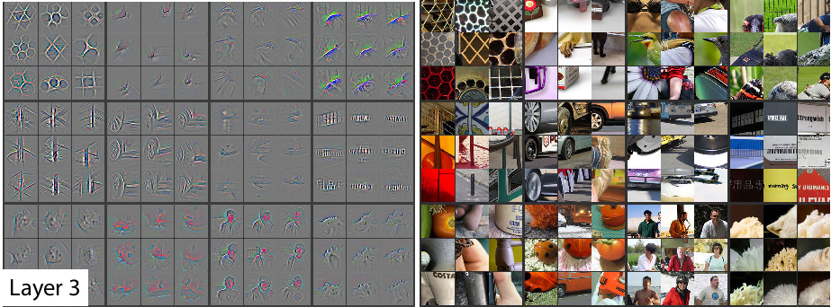
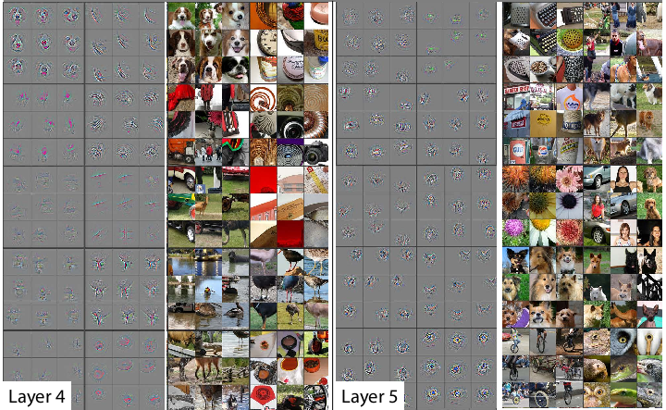
Learning Object Representations

Slide 31

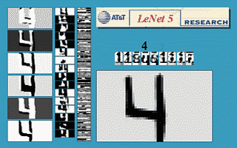
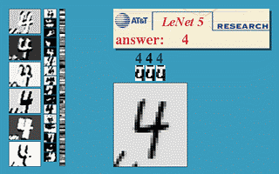
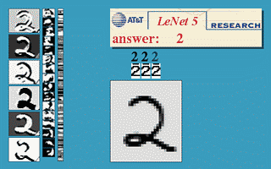
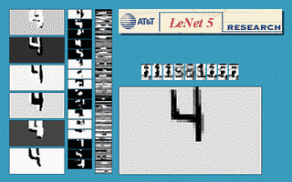
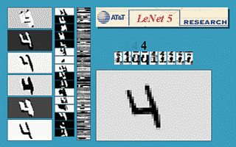
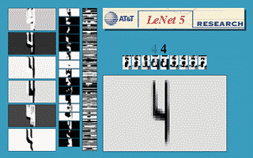
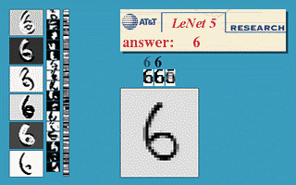
CNN for Hand-Writing Recognition

Slide 32
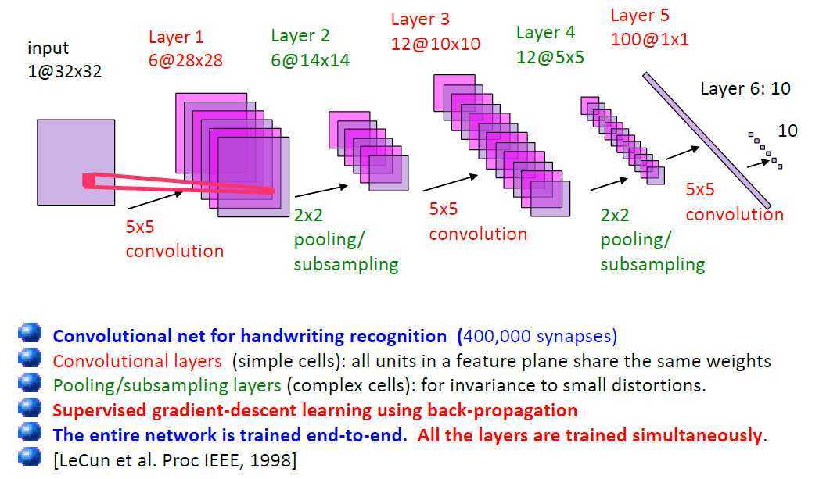
CNN for Hand-Writing Recognition

Slide 33

Invariance and Robustness to Noise

Slide 34

Applications - Scene Parsing
Scene parsing using inference Embedded Deep Networks

Slide 35

Applications - Scene Parsing
Scene parsing using inference Embedded Deep Networks

Slide 36


Applications - Human Pose Estimation
Joint Training of a Convolutional Network and a Graphical Model for Human Pose Estimation

Slide 37

Applications - Human Pose Estimation
Joint Training of a Convolutional Network and a Graphical Model for Human Pose Estimation

Slide 38

Applications - Face Detection and Pose Estimation

Slide 39

Applications - Face Detection

Slide 40

Applications - Learning Object Representations

Slide 41


Applications - Object Detection
Joseph Redmon, et al. YOLOv3: An Incremental Improvement

Slide 42

Developments

Slide 43
Conclusion
At runtime the convolution operations are computationally expensive and take up about 67% of the time.
Learned model can not adapt to other domain.
Need large amount training samples.
Without memory capability.
Need explicit structure inference.

